Slide 1
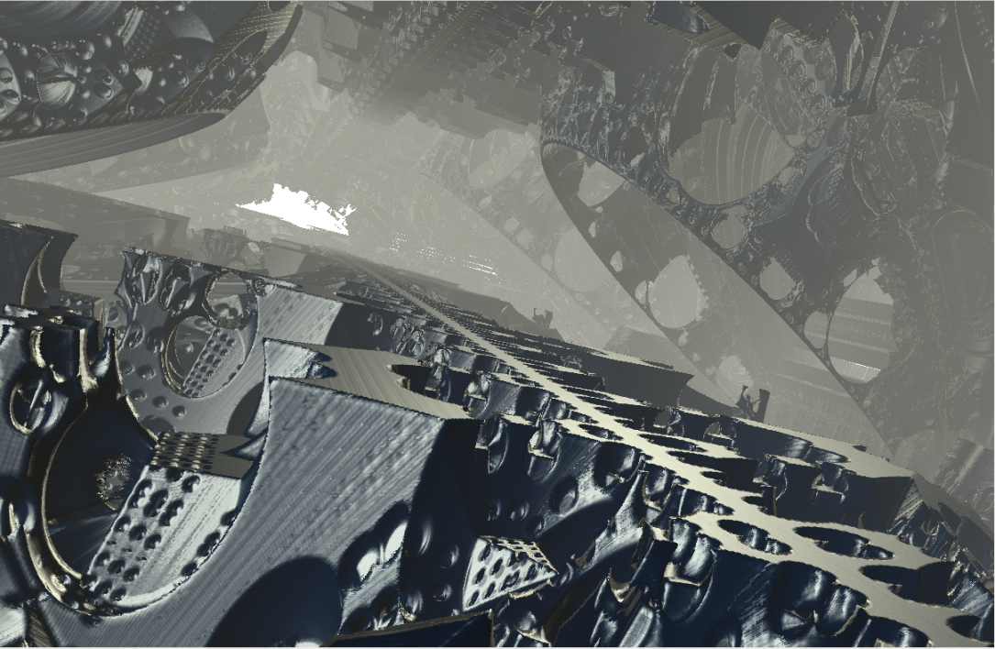
Introduction
Final project from 2011 by akenyon, kkutt, pporfili
CS123: Introduction to Computer Graphics
Notes:
Short clip on multitouch

Slide 2
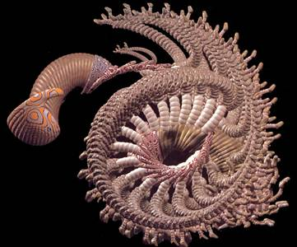
What is Computer Graphics? (1/2)
Computer graphics generally means creation, storage and manipulation of models and images
Such models come from diverse and expanding set of fields including physical, mathematical, artistic, biological, and even conceptual (abstract) structures
Frame from animation by William Latham, shown at SIGGRAPH 1992. Latham creates his artwork using rules that govern patterns of natural forms.

Slide 3
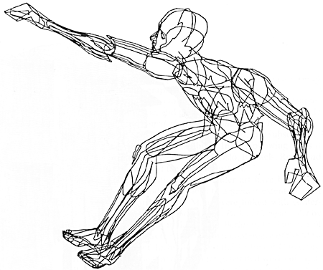
What is Computer Graphics? (2/2)
William Fetter coined term “computer graphics” in 1960 to describe new design methods he was pursuing at Boeing
Created a series of widely reproduced images on pen plotter exploring cockpit design, using 3D model of human body.
“Perhaps the best way to define computer graphics is to find out what it is not. It is not a machine. It is not a computer, nor a group of computer programs. It is not the know-how of a graphic designer, a programmer, a writer, a motion picture specialist, or a reproduction specialist.
Computer graphics is all these – a consciously managed and documented technology directed toward communicating information accurately and descriptively.”
Computer Graphics, by William A. Fetter, 1966

Slide 4
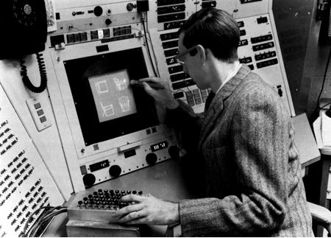
What is Interactive Computer Graphics? (1/2)
User controls contents, structure, and appearance of objects and their displayed images via rapid visual feedback
Basic components of an interactive graphics system
input (e.g., mouse, tablet and stylus, multi-touch…)
processing (and storage)
display/output (e.g., screen, paper-based printer, video recorder…)
First truly interactive graphics system, Sketchpad, pioneered at MIT by Ivan Sutherland for his 1963 Ph.D. thesis
Used TX-2 transistorized “mainframe” at Lincoln Lab
Note CRT monitor, light pen and function-key panel

Slide 5
Demo: Sketchpad
http://youtu.be/J6UAYZxFwLc

Slide 6

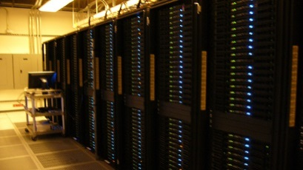
What is Interactive Computer Graphics? (2/2)
Almost all key elements of interactive graphics system are expressed in first paragraph of Sutherland’s 1963 Ph.D. thesis, Sketchpad, A Man-Machine Graphical Communication System:
The Sketchpad system uses drawing as a novel communication medium for a computer. The system contains input, output, and computation programs which enable it to interpret information drawn directly on a computer display. Sketchpad has shown the most usefulness as an aid to the understanding of processes, such as the motion of linkages, which can be described with pictures. Sketchpad also makes it easy to draw highly repetitive or highly accurate drawings and to change drawings previously drawn with it…
Today, we still use non-interactive batch mode for final production-quality video and film (special effects – FX). Rendering a single frame of Cars 2 (a 24 fps movie) averaged 11.5 hours on a 12,500-core render farm!
Render farm

Slide 7
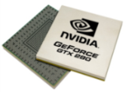
Enabling Modern Computer Graphics (1/5)
Hardware revolution
Moore’s Law: every 12-18 months, computer power improves by factor of 2 in price / performance as feature size shrinks
Significant advances in commodity graphics chips every 6 months vs. several years for general purpose CPUs
NVIDIA GTX 680… 3090.4 gigaflops
Newest processors are 64-bit, 2, 4, 6, 8, or 10 core
Intel Core i7 – consumer, up to 6 cores hyperthreaded to provide 12 threads
Intel Sandy Bridge EP– industrial, 8 cores HT, 16 threads
nVidia GeForceTM chip

Slide 8
Enabling Modern Computer Graphics (2/5)
Graphic subsystems
Offloads graphics processing from CPU to chip designed for doing graphics operations quickly
nVidia GeForce™, ATI Radeon™
GPUs used for special purpose computation, also bunched together to make supercomputers
GPU has led to development of other dedicated subsystems
Physics: nVidia PhysX PPU (Physics Processing Unit), standard on many NVIDIA GPUs
Artificial Intelligence: IBM Watson
Hardware show and tell: Dept’s new NVIDIA GeForce GTX 460s
1.35 GHz clock, 1GB memory, 37.8 billion pixels/second fill rate
Old cards: GeForce 7300 GT: 350 MHz clock, 256 MB memory, 2.8 billion fill rate

Slide 9
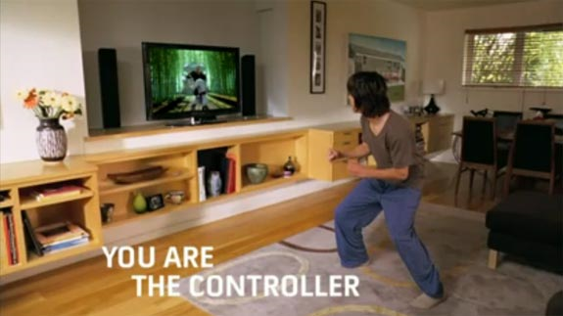
Enabling Modern Computer Graphics (3/5)
Input Devices
Mouse, tablet & stylus, multi-touch, force feedback, and other game controllers (e.g., Wii), scanner, digital camera (images, computer vision), etc.
Whole body as interaction device:
http://www.xbox.com/kinect

Slide 10
Kinect Technology Preview: “Milo”
http://youtu.be/2g_U02Pz0P4

Slide 11
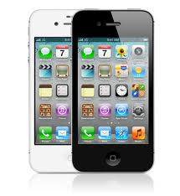
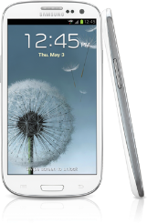
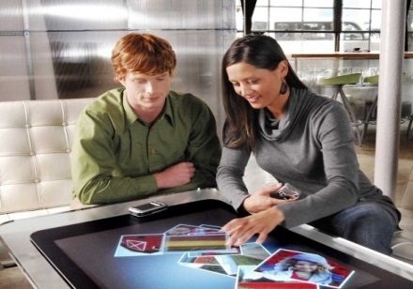
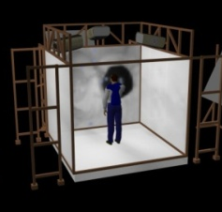
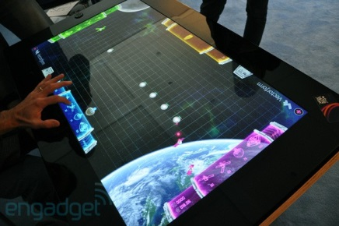
Enabling Modern Computer Graphics (4/5)
Many form factors
Cell Phones/PDAs (smartphones), laptop/desktops/tablets,
Microsoft PixelSense on Samsung SUR40 (successor to Microsoft Surface)
3D immersive virtual reality systems such as Brown’s new Cave being built at 180 George Street
Apple iPhone™
Samsung Galaxy SIII (Android)
Microsoft Surface
Samsung SUR40
Brown’s CaveTM

Slide 12
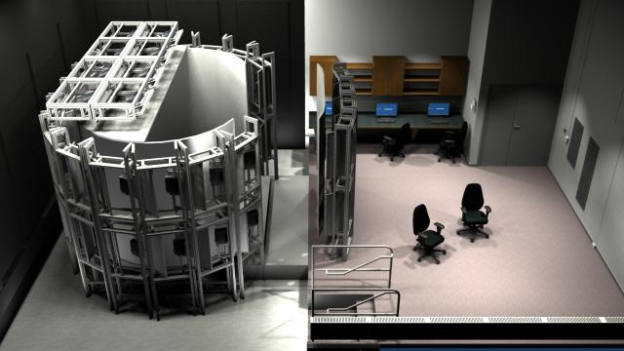
CAVE Redesign
Old Cave:
4 1024 x 786 projectors on 8’ x 8’ walls (8-10 pixels per inch)
Too low for many applications, and got worse (brightness, contrast deteriorated over time)
New Cave as planned:
70 1080p screens or projectors arranged in 8’ cylinder
Powered by a ~35 graphics machine cluster
No right angles, up to 40 pixels per inch (can’t see individual pixels at normal viewing distance)
Credit: John Huffman, Brown CCV

Slide 13
Enabling Modern Computer Graphics (5/5)
Software Improvements
Algorithms and data structures
Modeling of materials
Rendering of natural phenomena
“Acceleration data structures” for ray tracing
Parallelization
Most operations are embarrassingly parallel: changing value of one pixel is often independent of other pixels
Distributed and Cloud computing
Send operations into ‘cloud’, get back results, don’t care how
Rendering even available as internet service!

Slide 14
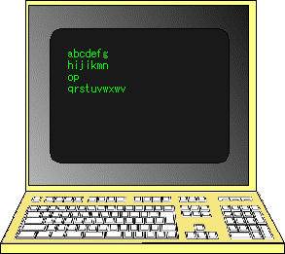
Environmental Evolution (1/5)
Character Displays (1960s – now)
Display: text plus alphamosaic pseudo-graphics (ASCII art)
Object and command specification: command-line typing
Control over appearance: coding for text formatting (.p = paragraph, .i 5 = indent 5)
Application control: single task

Slide 15
Environmental Evolution (2/5)
Vector (Calligraphic, Line Drawing)
Displays (1963 – 1980s)
Display: line drawings and stroke text; 2D and 3D transformation hardware
Object and command specification: command-line typing, function keys, menus
Control over appearance: pseudo-WYSIWYG
Application control: single or multitasked, distributed computing pioneered at Brown via mainframe host <-> minicomputer satellite
Term “vector” graphics survives as “scalable vector graphics” library from Adobe and W3C – shapes as transformable objects rather than just bitmaps

Slide 16
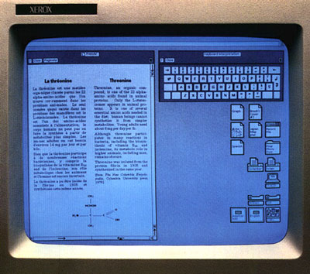
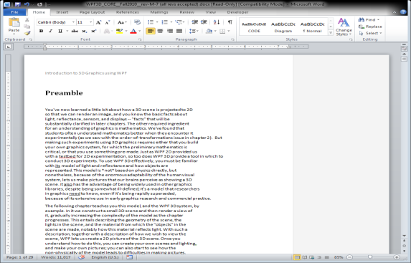
Environmental Evolution (3/5)
2D bitmap raster displays for PCs and workstations (1972 at Xerox PARC - now)
Display: windows, icons, legible text, “flat earth” graphics
Note: late 60’s saw first use of raster graphics, especially for flight simulators
Object and command specification: minimal typing via WIMP (Windows, Icons, Menus, Pointer) GUI: point-and-click selection of menu items and objects, widgets and direct manipulation (e.g., drag and drop), “messy desktop” metaphor
Control over appearance: WYSIWYG (which is really WYSIAYG, What You See Is All You Get)
Application control: multi-tasking, networked client-server computation and window management (even “X terminals”)
Above, a classic WIMP interface. The technology, at its core, remains largely the same today. Below, a modern WIMP interface.

Slide 17
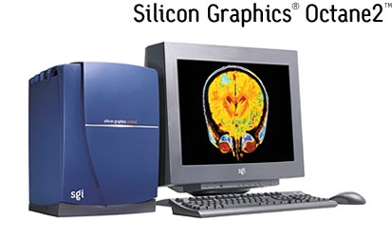
Environmental Evolution (4/5)
3D graphics workstations (1984 at SGI – now)
Display: real-time, pseudo-realistic images of 3D scenes
Object and command specification: 2D, 3D and N-D input devices (controlling 3+ degrees of freedom) and force feedback haptic devices for point-and-click, widgets, and direct manipulation
Control over appearance: WYSIWYG (still WYSIAYG)
Application control: multi-tasking, networked (client/server) computation and window management
Graphics workstations such as these have been replaced with commodity hardware (GPUs)

Slide 18
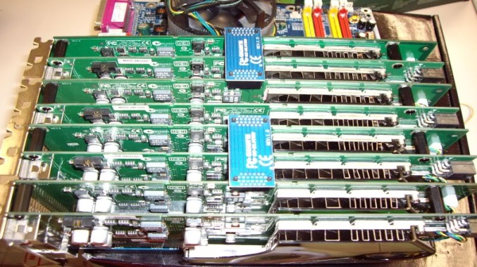
Environmental Evolution (5/5)
High-end PCs with hot graphics cards (nVidia GeForce™, ATI Radeon™) have supplanted graphics workstations
Such PCs are clustered together over high speed buses or LANs to provide “scalable graphics” to drive tiled PowerWalls, Caves, etc.
Now accessible to consumers via new technologies like NVIDIA’s SLI bridge
You can put multiple GPUs together in your computer using SLI.

Slide 19

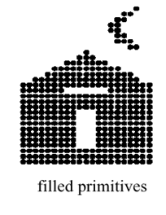
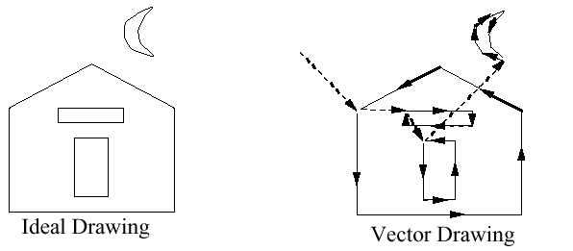
Graphics Display Hardware
Vector (calligraphic, stroke, random-scan)
Raster (TV, bitmap, pixmap) used in displays and laser printers
Driven by display commands (move (x, y), char(“A”) , line(x, y)…)
Survives as “scalable vector graphics”
Driven by array of pixels (no semantics, lowest form of representation)
Note “jaggies” (aliasing errors) due to sampling continuous primitives
Raster
Outline
Filled
Ideal Drawing
Vector Drawing

Slide 20
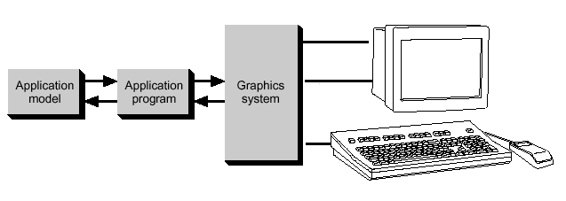
Conceptual Framework for Interactive Graphics
Graphics library/package is intermediary between application and display hardware (Graphics System)
Application program maps application objects to views (images) of those objects by calling on graphics library. Application model may contain lots of non-graphical data (e.g., non-geometric object properties)
User interaction results in modification of model and/or image
This hardware and software framework is more than 4 decades old but is still useful
Software
Hardware
Graphics
System/
GPU
Graphics
Library
Application
program
Application
Model / database

Slide 21




Graphics Library
Examples: OpenGL™, DirectX™, Windows Presentation Foundation™ (WPF), RenderMan™
Primitives (characters, lines, polygons, meshes,…)
Attributes
Color, line style, material properties for 3D
Lights
Transformations
Immediate mode vs. retained mode
immediate mode: no stored representation, package holds only attribute state, and application must completely draw each frame
retained mode: library compiles and displays from scenegraph that it maintains, a complex DAG. It is a display-centered extract of the Application Model

Slide 22
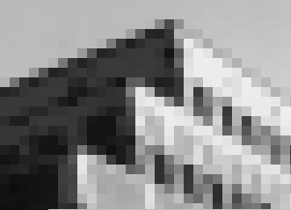
Application Distinctions: Two Basic Paradigms
Sample-based graphics: discrete samples are used to describe visual information
pixels can be created by digitizing images, using a sample-based “painting” program, etc.
often some aspect of the physical world is sampled for visualization, e.g., temperature across the US
example programs: Adobe Photoshop™, GIMP™ , Adobe AfterEffects™ (which came out of CS123/CS224!)

Slide 23
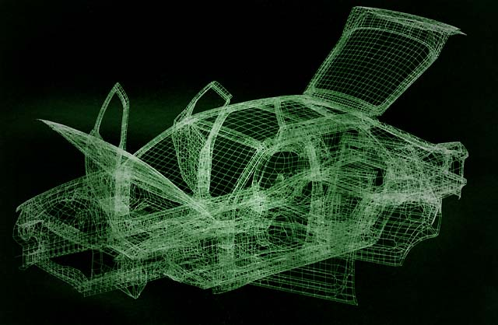
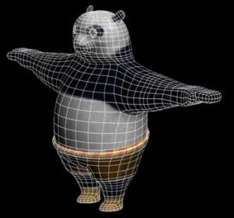
Application Distinctions: Two Basic Paradigms
Geometry-based graphics (also called scalable vector graphics or object-oriented graphics) : geometrical model is created, along with various appearance attributes, and is then sampled for visualization (rendering a.k.a image synthesis)
often some aspect of physical world is visually simulated, or “synthesized”
examples of 2D apps: Adobe Illustrator™, Adobe Freehand™, Corel CorelDRAW™
examples of 3D apps: Autodesk’s AutoCAD2010™, Autodesk’s (formerly Alias|Wavefront’s) Maya™, Autodesk’s 3D Studio Max™

Slide 24
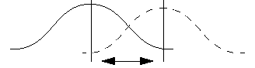
Sample-based Graphics (1/2)
Images are made up of grids of discrete pixels, or 2D “picture elements”
Pixels are point locations with associated sample values, usually of light intensities/colors, transparency, and other control information
When we sample an image, we sample the point location along the continuous signal and we cannot treat the pixels as little circles or squares
CRT beam illumination pattern
light intensity
1 pixel
Visualization of a
mathematical
pixel grid
Can’t resolve adjacent pixels on CRT
LCD display

Slide 25
Sample-based Graphics (2/2)
Samples created directly in paint-type program, or as sampling of continuous (analog) visual materials. E.g., photograph can be sampled (light intensity/color measured at regular intervals) with many devices including:
flatbed and drum scanners
digital still and motion (video) cameras
add-on boards such as frame grabbers
Sample values can also be input numerically (e.g., with numbers from computed dataset)
Once an image is defined as pixel-array, it can be manipulated
Image editing: changes made by user, such as cutting and pasting sections, brush-type tools, and processing selected areas
Image processing: algorithmic operations that are performed on image (or pre-selected portion of image) without user intervention. Blurring, sharpening, edge-detection, color balancing, rotating, warping.

Slide 26
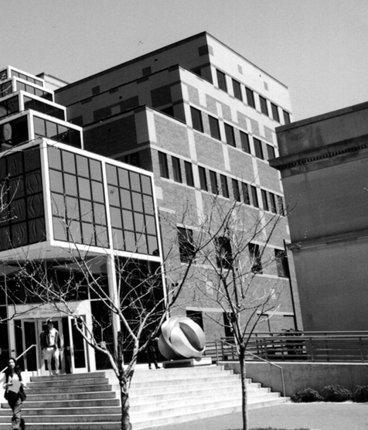

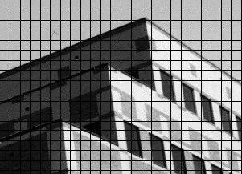
Sampling an Image
Lets do some sampling of CIT building
A color value is measured at every grid point and used to color corresponding grid square
Poor sampling and image reconstruction method creates blocky image
3D scene
0 = white, 5 = gray, 10 = black

Slide 27
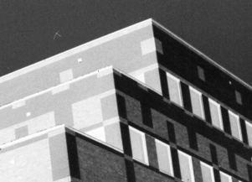
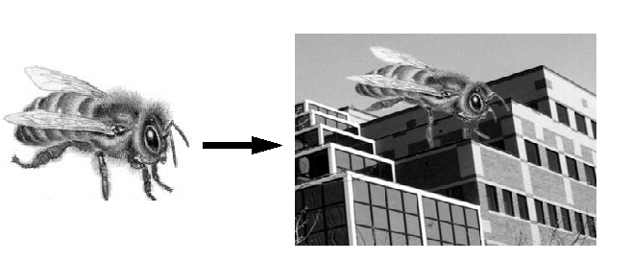
What’s the Advantage?
Once image is defined in terms of colors at (x, y) locations on grid, can change image easily by altering location or color values
E.g., if we reverse our mapping above and make 10 = white and 0 = black, the image would look like this:
Pixel information from one image can be copied and pasted into another, replacing or combining with previously stored pixels

Slide 28
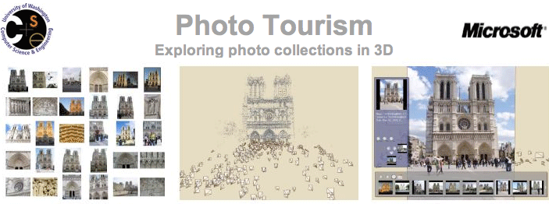
What’s the Disadvantage?
WYSIAYG (What You See Is All You Get): No additional information
no depth information
can’t examine scene from different point of view
at most can play with the individual pixels or groups of pixels to change colors, enhance contrast, find edges, etc.
But recently, strong interest in image-based rendering to fake 3D scenes and arbitrary camera positions. New images constructed by interpolation, composition, warping and other operations.
Take James Hays’s Computational Photography (CS1950G)
Photo Tourism: Exploring photo collections in 3D
(Siggraph 2006)

Slide 29
Geometry-Based Graphics
Geometry-based graphics applications store mathematical descriptions, or “models,” of geometric elements (lines, polygons, polyhedrons…) and associated attributes (e.g., color, material properties). Elements are primitive geometric shapes, primitives for short
Images created as pixel arrays (via sampling of geometry) for viewing, but not stored as part of model. Images of many different views are generated from same model
Users cannot usually work directly with individual pixels in geometry-based programs; as user manipulates geometric elements, program resamples and redisplays elements
Increasingly rendering combines geometric and sample-based graphics, both as performance hack and to increase quality of final product

Slide 30
What is Geometric Modeling?
What is a model?
Captures salient features (data, behavior) of thing/phenomenon being modeled
data includes geometry, appearance, attributes…
note similarity to OOP ideas
Real: some geometry inherent
physical (e.g., actual object such as a chair)
non-physical (e.g., mathematical function, weather data)
Abstract: no inherent geometry, but for visualization
organizational (e.g., company org. chart)
quantitative (e.g., graph of stock market)

Slide 31
What is Geometric Modeling?
Modeling is coping with complexity
Our focus: modeling and viewing simple everyday objects
Consider this:
Through 3D computer graphics, first time in human history we have abstract, easily changeable 3D forms. This has revolutionized working process of many fields – science, engineering, industrial design, architecture, commerce, entertainment, etc. This has profound implications for visual thinking and visual literacy…

Slide 32
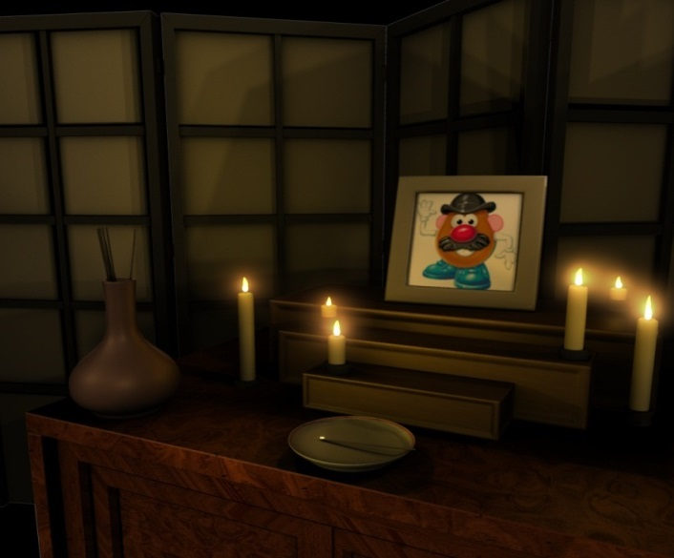
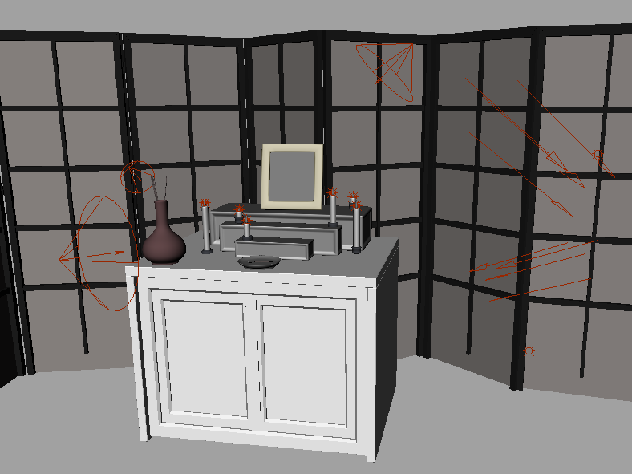
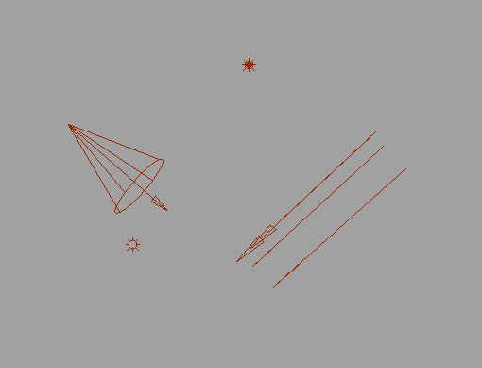
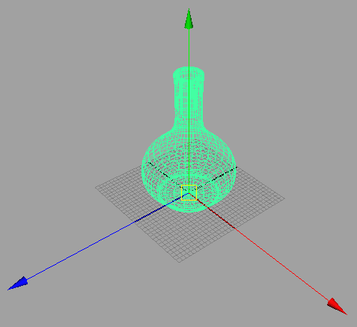
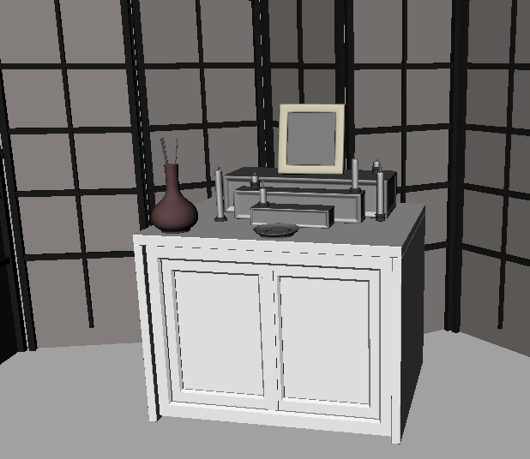
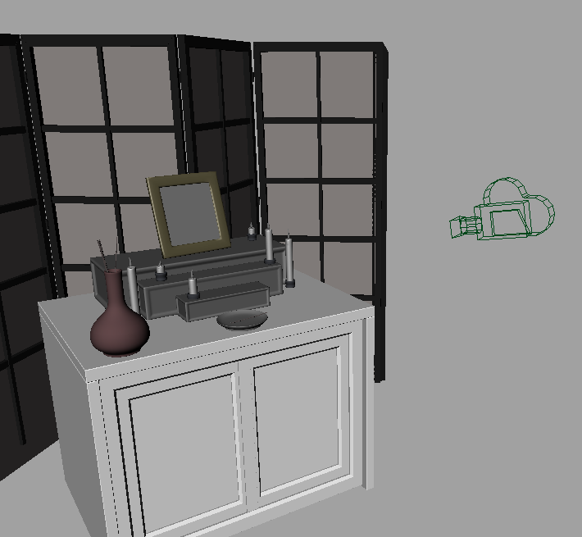
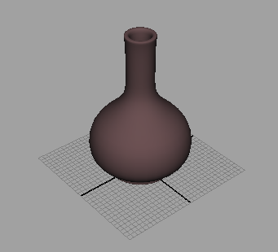
Modeling vs. Rendering
Rendering
Take “picture” with camera
Both can be done with commercial software:
Autodesk MayaTM ,3D Studio MaxTM, BlenderTM, etc.
Modeling
Create models
Apply materials to models
Place models around scene
Place lights in scene
Place the camera
Point Light
Spot Light
Directional Light
Ambient Light
CS128 lighting assignment by Patrick Doran, Spring 2009

Slide 33
Decomposition of a Geometric Model
Divide and Conquer
Hierarchy of geometrical components
Reduction to primitives (e.g., spheres, cubes, etc.)
Simple vs. not-so-simple elements (nail vs. screw)
Head
Shaft
Point
composition
decomposition

Slide 34
Hierarchical (Tree) Diagram of Nail
Object to be modeled is (visually) analyzed, and then decomposed into collections of primitive shapes.
Tree diagram provides visual method of expressing “composed of” relationships of model
Such diagrams are part of 3D program interfaces (e.g., 3D Studio MAX, Maya)
As a data structure to be rendered, it is called a scenegraph
Nail
root node
Head
(cylinder)
Body
Shaft
(cylinder)
Point
(cone)
leaf nodes
tree diagram

Slide 35
Composition of a Geometric Model
Translate
Translate and Scale
Translate and Rotate
Primitives
in their own modeling
coordinate system
Composition
in world (root)
coordinate system
Primitives created in decomposition process must be assembled to create final object. Done with affine transformations, T, R, S (as in above example).

Slide 36
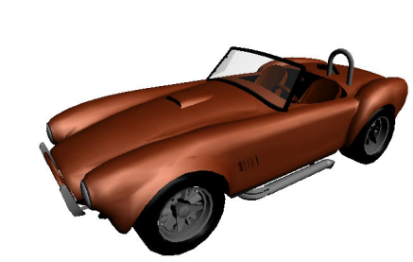
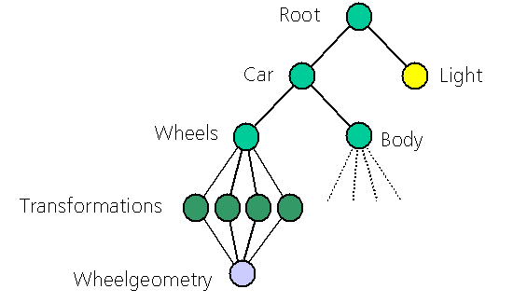
Upcoming Topics
We manipulated primitive shapes with geometric transformations (translation, rotation, scale). These transformations are essential for model organization, process of composing complex objects from simpler components.
Hierarchical models and geometric transformations are also essential for animation
Once object’s geometry is established, must be viewed on screen: map from 3D to 2D for viewing and from 2D to 3D for 2D input devices (e.g., the mouse or pen/stylus)
While mapping from 3D to 2D, object (surface) material properties and lighting effects are used in rendering one’s constructions. This rendering process is also called image synthesis.

